Slide 1
Module 5.1 – Planning
Introduction to Planning

Slide 2
Planning
Robots must make decisions that consider their entire environment
Robots would be ineffective if they only consider their immediate sensor measurements
Planning is the procedure of devising a strategy for achieving a goal based on a global perspective of the world.
Notes:
Consider a robot that is navigating a maze. If the robot never considers where it has been before and does not have a map of the environment, then the robot will be unable to guarantee that it can exit the maze
Planning involves considering places or states that have been visited and using knowledge of the environment to produce a strategy that is optimal or near-optimal given all available information
Often it will be impossible to produce a completely optimal plan because there the environment may be stochastic or only partially observable.
Even in a deterministic, fully observable world, the size of the environment may be too large for the robot to calculate the exact optimal plan to achieve its goal

Slide 3
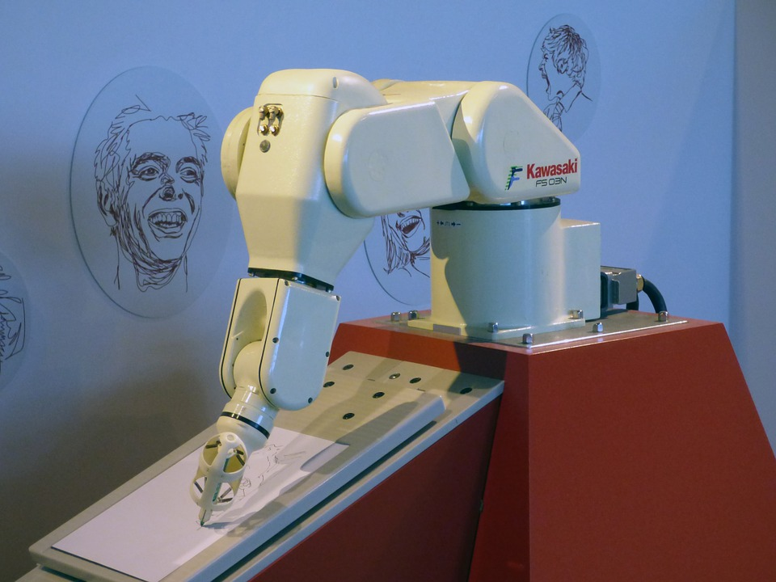
Robot Arms
Robot arms are used to grasp and move items.
Planning algorithms are used to define how the robot arm should move.
Notes:
It is critical that the chosen plan avoids collisions and ideally the amount of arm rotation should be minimized to complete the task quickly.
Robot arm planning is a computationally expensive procedure since many arms have 6-degrees of freedom and there are many ways for an arm to position its end effector.

Slide 4
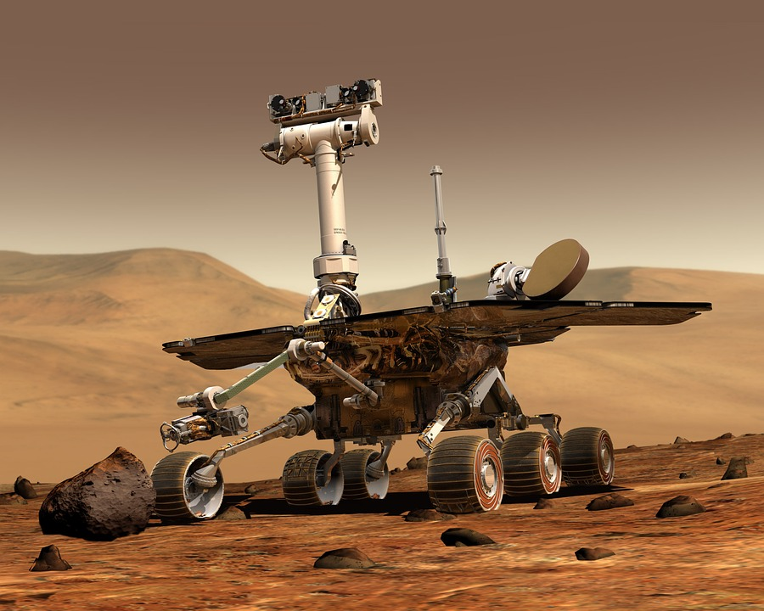
Navigation
One of the most important applications of planning is for navigation
Navigation typically involves two levels of planning:
global plans
local plans
Notes:
A global plan would be a path that tells the robot what order it should visit a set of coordinates
A local plan is how the robot can get from each coordinate in the global plan to the next coordinate
Global plans rely primarily on a map of the environment
Local plans rely on maps and sensor inputs.
The Mars rover example could perform global planning to plot a course that would take it to the peak of a mountain.
Then the local planning algorithm would guide the rover to avoid rocks and other obstacles as it traverses the path to the mountain top.

Slide 5

Game Playing
Robots can use planning to devise strategies in two or more player games.
When planning for games, the other player’s actions must be considered
Often plans must be revised after the other players perform actions.
Notes:
Although robots have learned to play human games like chess and soccer, games can to the broader category of environments where multiple entities are interacting to achieve similar or divergent goals
An autonomous car must make plans that consider all possible actions of the other drivers on the road. If a bus starts to overtake the autonomous car, the car may plan a way to get out of the way before a collision occurs

Slide 6
Representing the World with Maps
A map is any description of the environment that the robot can use to aide in planning.
Map Examples:
for robot arms, the position of obstacles and items are part of the map
for autonomous vehicles, the roads and intersections form the map
for chess, the locations of the pieces on the board constitute the map
Maps alone are insufficient for planning; robots must also know about the rules of their environment
Notes:
More complete maps are more useful to robots because the robot can more accurately determine what it should do.
Rules can include how the robot can change its environment with its actuators or how other objects can affect the robot.
For example, in chess the rules define what moves are valid for each piece. Robot arms have programmed rules that define how the arm’s position will change based on activation of its motors.

Slide 7
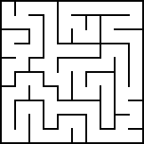
Navigation Maps
Maps for navigation should show where the navigable regions are
Navigation maps may also show the conditions of the areas
If there are important items (like fuel stations or opponents), those may also be present in a map.
Notes:
Robots typically deal with 2d or 3d maps for navigation.
The map on the slide is a maze that a robot may be trying to navigate. Without any map, the robot could keep going down pathways and backtracking until it found the exit.
With the map, the robot can plan the quickest path to an exit or goal.
Modern maps used for vehicle navigation are dynamic and can change to reflect traffic conditions.

Slide 8

Obstacle Expansion/Inflation
Often it is beneficial for robots to go wide around obstacles since maps can be wrong or the robot could slip
By artificially expanding the size of obstacles in the map, the robot will be forced to plan a path that is safe
Notes:
Robot movement, localization, and maps may be imprecise, so avoiding close encounters with obstacles or hazards is important.
Defining how much to expand obstacles is dependant on the environment and the robot

Slide 9
Missing or Incorrect Information
Rarely will a map be a perfect representation of the environment
Maps may be incorrect or not up-to-date
Maps may also have portions that are unknown
Notes:
Robots can deal with inaccurate maps by validating that their sensors match the expected sensor readings if the map were correct
If a robot’s sensors do not match what is expected given the robot’s position in the map, then the map may be incorrect or the robot may not be where it estimates it is.
The problem of localizing the robot within a map is discussed in module 7.
Portions of a map that are missing can be filled in by the robot if it visits those locations.

Slide 10
Exploration and Exploitation
When presented with an incomplete map a robot has two choices:
Develop the most optimal plan to a goal using only the known portion of the map
Explore the unknown portion of the map to attempt to find a more optimal route
These two strategies can be combined by occasionally exploring and occasionally using the best known path
Notes:
Exploration vs. Exploitation is a famous dilemma in planning and reinforcement learning domains.
If a robot will have to navigate between certain points many times, it is likely worthwhile to explore some of the map to locate a better path since the benefits of finding a faster path will be realized many times
A classical problem that studies the tradeoff between exploration and exploitation is the Multi-Armed Bandit

Slide 11
The GPU Teaching Kit is licensed by NVIDIA and California Polytechnic State University under the Creative Commons Attribution-NonCommercial 4.0 International License.

